Slide 1
Embedded Linux Porting
Linux Kernel

Slide 2
Topics
Linux Kernel ARCH
Kernel Dir Structure
Kernel Layers H/W dependent ( BSP ) and independent
Kernel Build System ( KConfig )
Compiling Linxu Kernel
Kernel Modules Compilation
Adding new driver
Changing the kernel Banner Name

Slide 3
What is Kernel ?
Kernel is the core part of an operating system. It is a program that manages the system resources (such as CPU, memory, and peripheral devices) and provides essential services for other software running on the computer. The kernel acts as a bridge between the hardware and the user-level applications.
. It contains zimage and .dtb fil

Slide 4
Zimage
A zImage is a compressed Linux kernel image that is commonly used on systems with limited storage or in situations where minimizing the kernel size is a priority.
The "z" in zImage stands for "zlib," which is a compression library used to compress the kernel image. The compression helps reduce the size of the kernel, making it more feasible for systems with constrained resources.
The zImage file is typically a self-extracting compressed kernel image that the bootloader can load into memory and decompress before executing.

Slide 5
Device Tree Blob (DTB):
* The Device Tree is a data structure that describes the hardware components and their configuration on a system. It provides a way for the kernel to obtain information about the hardware platform dynamically.
*The Device Tree Blob (DTB) is a binary representation of the Device Tree data. It is a compact, serialized form of the Device Tree used by the Linux kernel during the boot process.

Slide 6
Kernel Source
Browse Source:
https://github.com/rugged-board/linux-rba5d2x.git
Download U-Boot for RuggedBOARD
$ wget https://github.com/rugged-board/linux-rba5d2x/archive/linux-rba5d2x.zip Or
$ git clone https://github.com/rugged-board/linux-rba5d2x.git

Slide 7
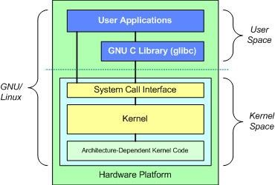
Kernel ARCH
OS Components
Linux Kernel Layout
Scheduler
Process Mgmt Memory Mgmt Device Mgmt

Slide 8
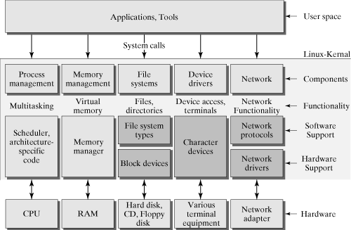
Kernel ARCH

Slide 9
Kernel Dir Structure
linux/arch/arm/kernel | Arch & Core specific code
linux/arch/arm/plat-<soc> | SOC specific code
Linux/arch/arm/mach-<soc> | Board directory contains board files
linux/arch/arm/boot/dts | device tree directory consists of device tree files for SOC, SOM, SBC sama5d2.dsi , rb_a5d2x.dtsi, rugged_board_a5d2x.dts
linux/arch/arm/boot | Linux Kernel Boot-strap
linux/arch/arm/configs | Contains board default configuration file used to configure kernel for a specific board. <boardname_defconfig> for ruggedboard we have rb_a5d2x_defconfig
linux/drivers | Contains bus drivers & device drivers (gpio, serial, i2c, spi, mmc, usb, net) Device Driver: rtc/ds1307.c, misc/i2c_eeprom.c …
linux/kernel | Linux Kernel core logic H/W Independent
linux/init | Kernel init code main.c (Start point of Kernel C code)
linux/fs | File System Supported by linux kernel

Slide 10
Kernel Kconfig
<boardname>_defconfig
KConfig
C Files
Vmlinx/ zImage
/uImage
make
<boardname>_ defconfig
make
menuconfig
make
.config
Makefile
<driver>.ko

Slide 11
Compiling Linxu Kernel
#1 Download the source #2 Set the toolchain
#3 Clean the source only for the first time
$make distclean
#4 Configure the kernel source for ruggedboard-a5d2x
$make rb_a5d2x_defconfig
#5 Do additional configuration if required using menuconfig
$make menuconfig
#6 Compile the Kernel code
$make

Slide 12
Kernel Modules Compilation
Kernel Modules can be compiled as
- Satic modules part of Linux Kernel Image
- Dynamic modules .ko files which should be copied to RFS
#In Makefile
obj-$(CONFIG_<MODULE>) += module.o
#In menuconfig we can select as * or M which will result
Obj-y // ‘*’ option Static Module
obj-m for M // ‘M’ Dynamic Module

Slide 13
Adding new Driver
#Step-1: Define your device in dts file # Step-2: Define your driver sled.c in linux/driver/misc folder $ vim linux/driver/misc/sled.c # Step-3: Add sled configuration in Kconfig file $ vim linux/driver/misc/Kconfig # Step-4: Add sled entry to Makefile $ vim linux/driver/misc/Makefile # Step-5: Enable the SLED from Menuconfig or add it in board_dfconfig file under linux/arch/arm/configs

Slide 14
Adding Driver in kernel in static way
Step1:
copy sled.c drivers/misc/
Step2:
vim drivers/misc/Makefile
obj-$(CONFIG_SLED) += sled.o
Step3:
vim drivers/misc/Kconfig
Step4:
Describe Hardware in a5d2x_rugged_board_common.dtsi file....
$ make rb_a5d2x_defconfig
$ make menuconfig
$ make -j4
=> zImage present in /arch/arm/boot/ copy into BOOT dir of SD Card for SD Card Flash and for NOR Flash copy into /var/lib/tftpboot/ and then copy to NOR flash
=> a5d2x_rugged_board.dtb present in /arch/arm/boot/dts/ copy into BOOT dir of SD Card for SD Card Flash and for NOR Flash copy into /var/lib/tftpboot/ and then copy to NOR flash

Slide 15
Adding Driver in kernel in dynamic way )
Step1:
copy sled.c drivers/misc/
Step2:
vim drivers/misc/Makefile
obj-$(CONFIG_SLED) += sled.o
Step3:
vim drivers/misc/Kconfig
Step4:
Describe Hardware in a5d2x_rugged_board_common.dtsi file....
$ make rb_a5d2x_defconfig
$ make menuconfig
$ make -j4
=> zImage present in /arch/arm/boot/ copy into BOOT dir of SD Card for SD Card Flash and for NOR Flash copy into /var/lib/tftpboot/ and then copy to NOR flash
=> a5d2x_rugged_board.dtb present in /arch/arm/boot/dts/ copy into BOOT dir of SD Card for SD Card Flash and for NOR Flash copy into /var/lib/tftpboot/ and then copy to NOR flash
=> sled.ko present in /driver/misc/ copy into /rootfs/home/ of SD Card
after booting the board
$ cd /home/
$ insmod sled.ko ===>to insert the driver
$ ./blinky

Slide 16
Kernel Banner change
1.Enable the toolchain . /opt/poky-tiny/2.5.2/environment-setup-cortexa5hf-neon-poky-linux-musleabi
2. Cd init
3. Vi version.c
4. Change the banner name
5. Make distclean
6.make rb-a5d2x-defconfig
7.make
8.cd arch/arm/boot
9.cp Zimage /var/lib/tftp
9.cd dts
10.cp a5d2x.rlb.dtb /var/lib/tftp

Slide 17
Thank You

